Slide 1
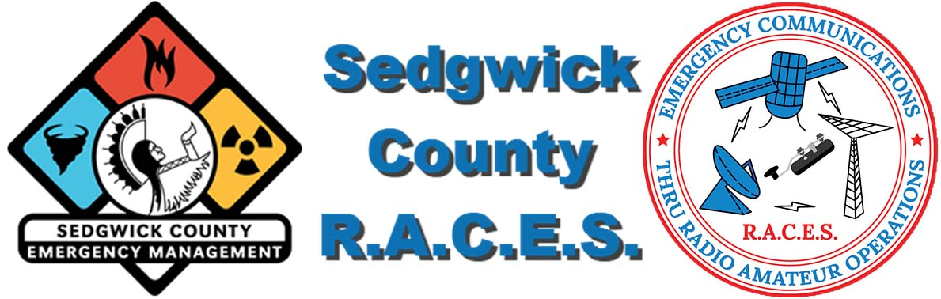
Exploring the Intersection of Drones and Amateur Radio
By KDØHTI, Brandon Trube
Notes:
Today, we're at the forefront of a technological evolution where drones are enhancing the capabilities of amateur radio operations.
Firstly, let's consider weather spotting. Drones offer a unique aerial perspective, providing valuable data that can improve the accuracy of weather observations and predictions.
This bird's-eye view is especially useful in tracking and monitoring storm development.
In terms of damage assessment and site surveys, drones are game-changers. They enable us to quickly and safely assess areas that are otherwise difficult to access, especially after a severe weather event.
This not only speeds up the assessment process but also keeps our team members safe.
Drones also have the potential to revolutionize how we deploy equipment in the field. Imagine deploying an emergency repeater to enhance communication capabilities in remote or disaster-stricken areas.
This could significantly extend our reach and effectiveness.
Moreover, drones simplify tasks like antenna inspections. They provide an easy way to visually inspect antennas and other installations, reducing the need for hazardous climbs or expensive equipment.
Looking ahead, the integration of drones into amateur radio operations is poised to expand.
Their potential to aid in emergency response, infrastructure monitoring, and communication is vast and still largely untapped. As we continue to explore these possibilities, drones could well become a staple tool in our amateur radio toolkit

Slide 2

Synergizing Drones with Amateur Radio: Expanding Horizons
Drones and amateur radio, two seemingly unrelated technologies, are a perfect match. Together, they open a world of possibilities that were once impossible to achieve.
From weather spotting to capturing informative video and photos, to antenna inspections made easy, the potential applications of these technologies are vast.
Notes:
The integration of drones into amateur radio represents a significant leap forward in technological synergy. These two fields, initially distinct, come together to create a suite of possibilities that were previously beyond our reach.
Drones bring a new dimension to weather spotting. They allow us to gather visual data and insights from vantage points that are otherwise inaccessible, enhancing our understanding of weather patterns and enabling more accurate predictions.
Beyond weather monitoring, drones equipped with cameras open up new avenues for capturing informative videos and photographs. This can be invaluable in a range of applications from documenting events to conducting educational workshops.
One of the most practical applications lies in antenna inspections. Drones simplify this task, allowing for detailed inspections without the risks and logistics involved in manual checks. This not only saves time but also ensures safety, particularly in challenging environments.
In essence, the combination of drones and amateur radio is more than just a technological advancement; it's a transformative tool that broadens our capabilities and opens up new possibilities for innovation and efficiency in our field.

Slide 3
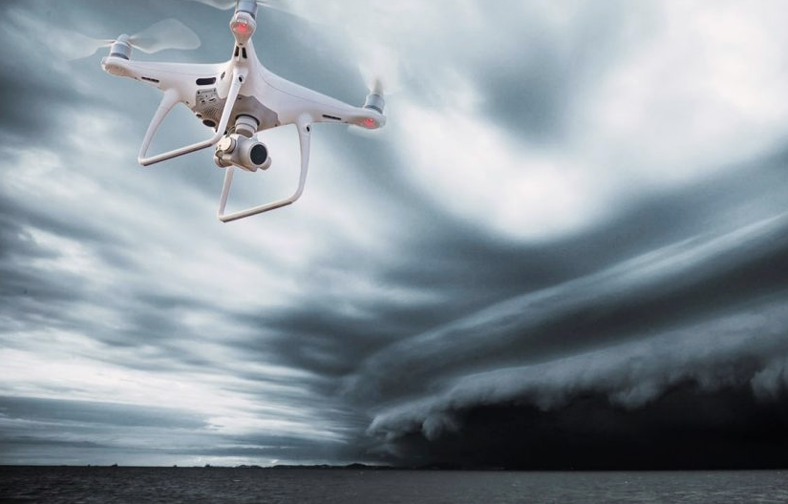
Revolutionizing Weather Spotting with Drone Technology
Drones have become an invaluable tool for weather spotting. With their ability to fly at high altitudes and cover large areas quickly, drones can provide real-time data on weather patterns and changes.
One of the biggest benefits of using drones for weather spotting is their cost-effectiveness.
Notes:
Drones have emerged as a groundbreaking tool in the realm of weather spotting. Their ability to soar to high altitudes and traverse large areas swiftly enables us to gather critical real-time data on evolving weather patterns, something that was far more challenging and resource-intensive in the past.
One of the standout advantages of using drones in this capacity is their cost-effectiveness. Compared to traditional methods of weather data collection, such as manned aircraft or extensive ground operations, drones offer a more economical solution. They require less manpower and can operate in a variety of weather conditions, providing detailed and accurate insights.
The information gathered by drones is not just timely; it's also comprehensive. From capturing cloud formations and tracking storm movements to monitoring temperature and humidity levels, drones equip us with a wealth of data. This data can significantly enhance our understanding of weather systems, leading to improved forecasting and better preparedness for adverse weather conditions.
In essence, drones are not just expanding our capabilities in weather spotting; they are reshaping the way we approach it. Their integration into our operations signifies a step forward into a new era of technological advancement in amateur radio and weather observation.

Slide 4
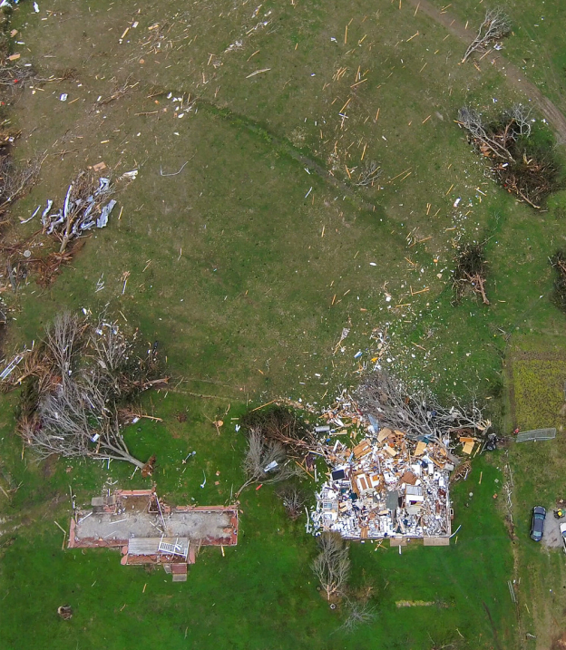
Enhancing Emergency Response with Drone-Assisted Surveys
Drones have revolutionized the way we capture video and photos. With their ability to fly high and maneuver in tight spaces, they offer a unique perspective that was once only possible with expensive equipment and skilled pilots.
By employing drone technology for Emergency Response we can gather information about a disaster site quickly and safely.
Notes:
Welcome to an exciting development in our emergency response toolkit: the use of drones for damage assessments and site surveys. Drones have truly revolutionized our approach to capturing video and photos in disaster management.
Their ability to soar to great heights and navigate through tight spaces has opened up perspectives that were previously out of reach without costly equipment and specialized piloting skills.
In emergency response scenarios, drones are more than just a technological advancement; they are a critical asset.
They enable us to quickly and safely gather detailed information about a disaster site. This rapid assessment capability can be crucial in strategizing rescue operations and managing resources efficiently.
But drones aren't just for professionals. Even if you're not a seasoned photographer, drones offer an incredible opportunity to capture stunning footage. Imagine the impact of aerial views of events and activities, providing a unique vantage point that ground-level footage simply cannot match.
Today, integrating drone technology into our emergency response package is not just an option – it's a necessity. It enhances our ability to respond effectively and safely to emergencies, providing invaluable data and perspectives that help us serve our community better

Slide 5
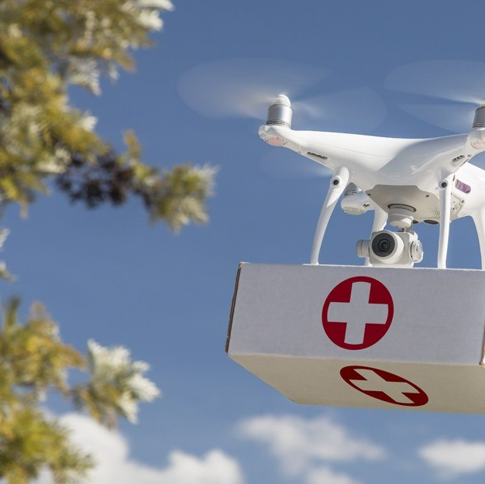
Revolutionizing Equipment Deployment with Drone Technology
Amateur radio enthusiasts have long been known for their ingenuity and resourcefulness in finding new ways to communicate over long distances.
With the advent of drones, these same enthusiasts now have a powerful new tool at their disposal.
Drones can be used to quickly deploy emergency communications equipment in disaster zones, providing critical lifelines to those in need.
Notes:
Amateur radio has always been at the forefront of communication innovation, especially in challenging situations. With the introduction of drones into our toolkit, we've unlocked a whole new dimension of possibilities in deploying equipment.
Drones aren't just about capturing images from the sky; they've become a crucial asset in emergency response. Consider a disaster zone where traditional communication lines are down, and access is hindered by road blockages, floodwaters, or fire. In such scenarios, drones can swiftly and safely deliver emergency communications equipment, such as handheld radios, to those cut off from the rest of the world.
This capability is not just innovative; it's potentially life-saving.
The ability to quickly deliver a handheld radio to someone in a remote, inaccessible area exemplifies how drones can bridge the gap in critical communication needs. This is particularly vital in emergency situations where every second counts, and traditional methods of equipment deployment are not feasible.
By embracing drone technology, amateur radio enthusiasts are not only continuing their legacy of communication ingenuity but are also significantly enhancing our capacity to provide timely aid and maintain communications in the most challenging conditions.

Slide 6
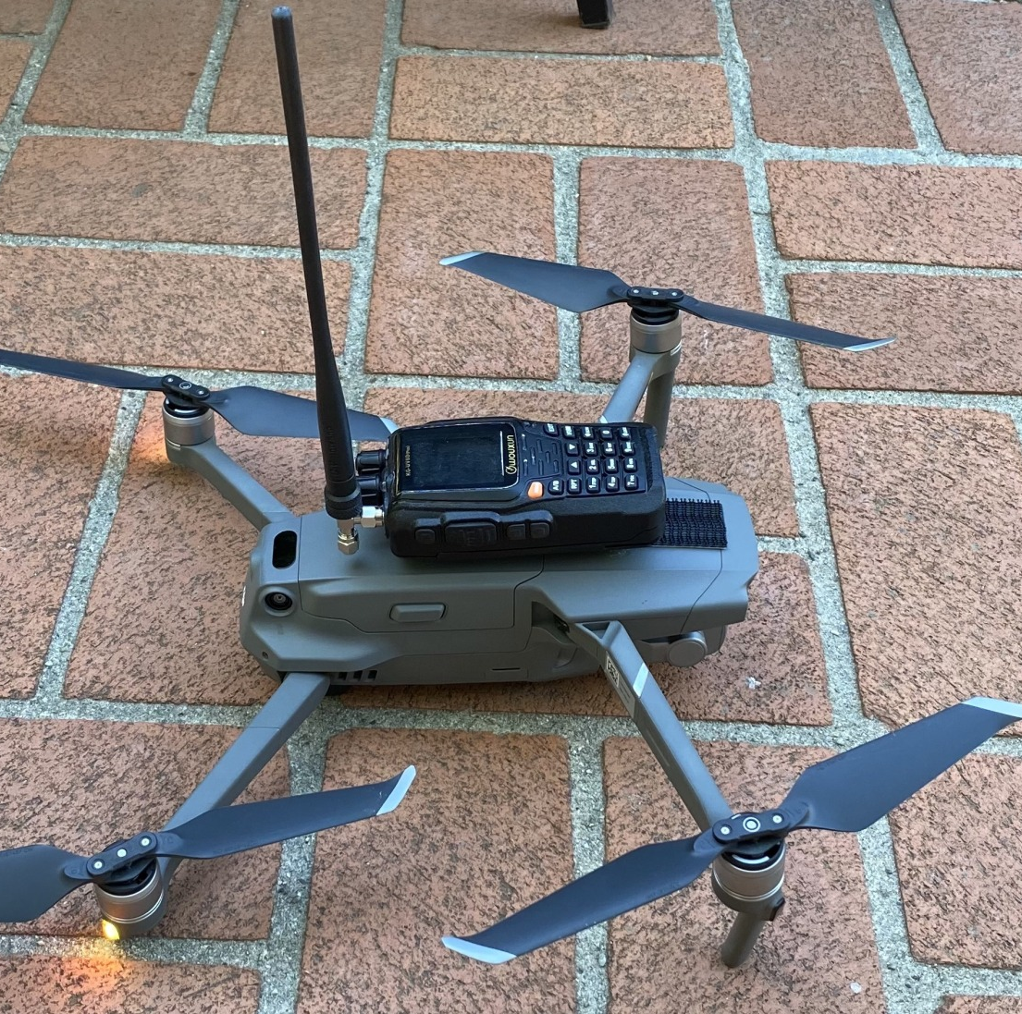
Drone-Deployed Emergency Repeaters: Elevating Communication
One creative use is to use a drone to set up an emergency repeater. By mounting a small portable repeater one can use a drone to deliver the repeater package to a elevated position that may otherwise be inaccessible.
A 3D printer can even be used to make custom brackets for this type of setup.
Notes:
In the realm of amateur radio, innovation never ceases, and drones have opened up a new frontier in emergency communication. A particularly creative application is the use of drones to set up emergency repeaters. Imagine the scenario where traditional repeater locations are inaccessible due to various constraints - this is where our drone technology steps in.
By attaching a small, portable repeater to a drone, we can position it at an elevated spot, greatly enhancing our communication range, especially in challenging terrains or disaster-stricken areas. This approach not only overcomes geographical limitations but also ensures uninterrupted communication in critical times.
Furthermore, the adaptability of this setup is enhanced with tools like 3D printers, which can be used to create custom brackets for mounting the repeater on the drone. This level of customization allows for precise and efficient deployment tailored to specific needs and conditions.
Through this innovative use of drones and amateur radio technology combined, we are not just staying connected; we are redefining the boundaries of emergency communication. This is a testament to the ingenuity and resourcefulness inherent in the amateur radio community.

Slide 7
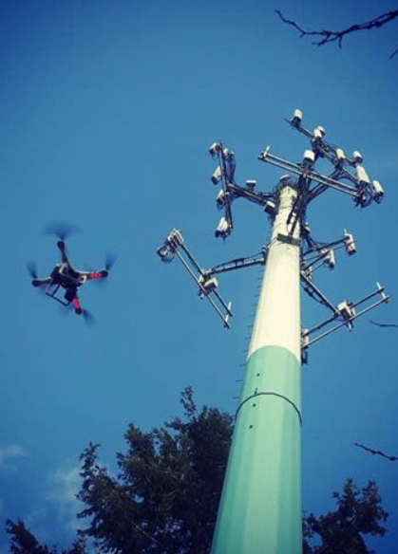
Transforming Antenna Inspections with Drone Technology
Drones have revolutionized the way we inspect antennas. With their ability to fly at various heights and angles, they can provide a detailed view of the antenna and identify possible issues without the cost of a tower climb.
This allows for faster, more accurate, and safer inspections, as well as easy identification of any issues, and a significant cost savings.
Notes:
Drones have brought a paradigm shift in how we conduct antenna inspections. No longer do we need to rely solely on costly and potentially hazardous tower climbs to assess the condition of our antennas. With the flexibility and agility of drones, we can now get up-close and detailed views of antennas from various heights and angles.
This aerial perspective is invaluable. It enables us to pinpoint issues that might be invisible from the ground or hard to reach through traditional means. We can inspect for structural integrity, cable connections, wear and tear, and any weather-related damage with unprecedented ease and precision.
The safety aspect cannot be overstated. Using drones significantly reduces the risk factor involved in climbing towers, especially under adverse weather conditions or in remote locations. Moreover, the cost savings are substantial. By deploying drones, we cut down on the resources and time traditionally needed for antenna inspections.
In essence, the integration of drone technology into our antenna maintenance routines represents a safer, more efficient, and cost-effective approach. It's an excellent example of how embracing new technology can greatly enhance our operational capabilities in amateur radio

Slide 8

Commercial Drone Operation: Licensing and Regulations (Commercial – For Profit)
You do not need a drone license if your drone use is recreational and falls within the scope of 44809, however, to fly your drone commercially or under the FAA's Small UAS Rule (Part 107), you must first obtain a Remote Pilot Certificate (RPC), also known as a drone license or a Part 107 certificate.
This certificate demonstrates that you understand the regulations, operating requirements, and procedures for safely flying drones.
To become a pilot you must:
Be at least 16 years old
Be able to read, speak, write, and understand English
Be in a physical and mental condition to safely fly a drone
Pass the initial aeronautical knowledge exam: "Unmanned Aircraft General – Small (UAG)"
Notes:
Let's delve into the realm of drone licensing, a critical aspect for those considering the commercial use of drones. It's important to distinguish between recreational and commercial drone usage.
For recreational drone pilots operating under the scope of Section 44809, a license is not required. However, if you intend to use your drone for commercial purposes, or under the FAA's Small UAS Rule, Part 107, obtaining a Remote Pilot Certificate, also known as a drone license, becomes mandatory.
This certificate is more than just a formal requirement. It's a testament to your understanding of the rules and regulations that govern the safe operation of drones in various airspaces. It ensures that you are well-versed in the operational requirements and the procedures necessary to fly drones safely and responsibly.
To embark on the journey of becoming a certified drone pilot, there are a few prerequisites. You must be at least 16 years old and have the ability to read, speak, write, and understand English. Equally important is your physical and mental condition, as it's vital to ensure that you can operate a drone safely.
The key step in obtaining this certification is passing the initial aeronautical knowledge exam titled 'Unmanned Aircraft General – Small (UAG).' This exam covers a wide range of topics essential to drone operation, from airspace classification to emergency procedures.
As drone technology becomes increasingly integrated into our operations, understanding and adhering to these licensing requirements is crucial for those looking to explore the commercial aspect of drone usage.

Slide 9
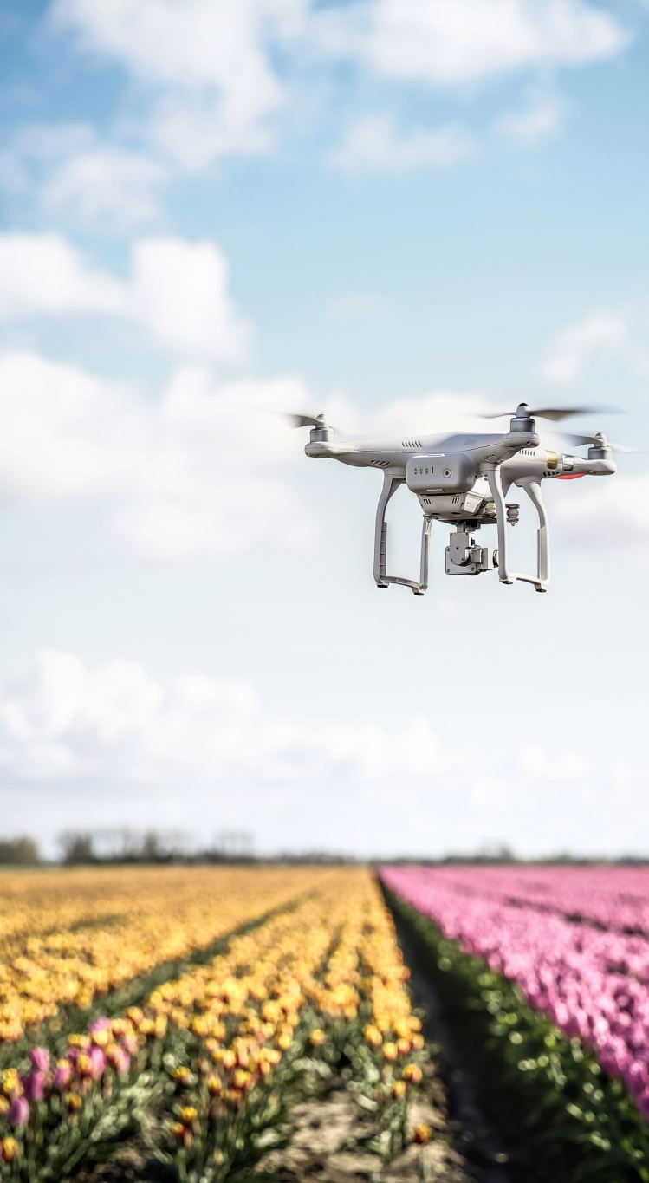
FAA Drone Registration: Requirements and Process
All drones that weigh more than 0.55 pounds (250 grams) must be registered with the FAA before they are flown. Drones that weigh less than this can be flown without registration, but you must follow the other rules and regulations set forth by the FAA.
The process for registering a drone is fairly simple. You can do it online in just a few minutes. You'll need to provide your name, address, and email address. You'll also need to create a unique identifier for your drone. Once you've registered your drone, you'll receive a certificate of registration that you must keep with you when you fly.
Notes:
In the world of drones, particularly when we intersect this technology with amateur radio, it's crucial to understand the legal requirements, starting with registration.
The Federal Aviation Administration mandates that all drones weighing more than 0.55 pounds, or 250 grams, must be registered before they are flown. This is an essential step in ensuring accountability and safety in our airspace.
If your drone weighs less than this limit, you are exempt from the registration requirement. However, this does not mean you can disregard the other rules and regulations set by the FAA. Compliance with these rules is non-negotiable, regardless of your drone's size.
The registration process itself is straightforward and user-friendly. It can be completed online within a few minutes. You'll need to provide some basic information, including your name, address, and email. Additionally, you'll create a unique identifier for your drone. Once registered, you'll receive a certificate of registration, a crucial document that must accompany you whenever you fly your drone.
Let's take the DJI Mini 2 as an example. It's a popular choice among amateur users because it falls under the 250g limit, negating the need for a license. But it's important to remember that even though it's small and exempt from licensing, it's not just a toy. The DJI Mini 2, like all drones, is a sophisticated piece of technology that requires responsible handling.
Remember, responsible drone operation starts with understanding and adhering to these regulatory requirements. By doing so, we ensure not only our compliance but also the safety and integrity of our hobby and public airspace.

Slide 10

The Future of Drones and Envisioning the Future: Drones and Amateur Radio Radio
As we look to the future of drones and amateur radio, the possibilities are endless. With advancements in technology, we can expect to see even more innovative uses for these tools in the years to come.
From disaster relief efforts to scientific research, the potential for drones and amateur radio to make a positive impact on society is immense.
Notes:
As we stand at the intersection of drones and amateur radio, the horizon of possibilities stretches far and wide. With each advancement in technology, we are witnessing the emergence of new and innovative applications of these tools. The future holds immense potential for these technologies to positively impact various facets of society, from disaster relief to scientific research.
One particularly promising area is environmental monitoring. Imagine harnessing the capabilities of drones and amateur radio in unison to collect comprehensive data about our environment. Drones can access remote and challenging terrains to gather crucial information about air quality, water resources, and wildlife populations. Amateur radio, with its robust communication capabilities, can relay this data in real-time, providing valuable insights for environmental conservation efforts.
This collaboration has the power to revolutionize how we interact with and understand our natural world. It opens up opportunities not just for observation and study but also for proactive intervention in protecting our planet. As we continue to explore these synergies, drones and amateur radio are set to play a vital role in shaping a sustainable future for our planet and its inhabitants.

Slide 11
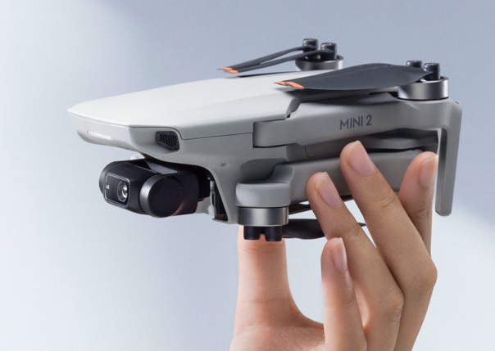
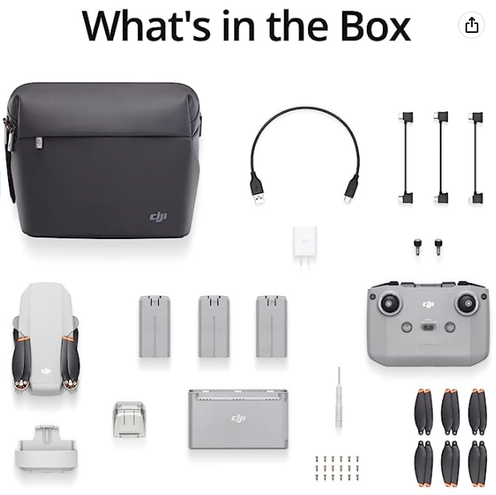
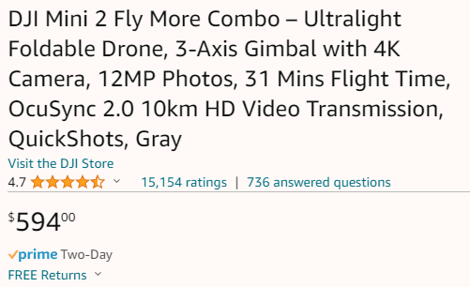
DJI Mini 2
At less than 249 g, it weighs about as much as an apple and fits in the palm of your hand.
With a max battery life of 31 minutes, DJI Mini 2 grants more than enough time to compose the perfect shot.
Mini 2 can resist level 5 winds and take off at a max altitude of 4,000 meters, so your footage is stable even when flying along a windy coastline or high above an alpine forest.
A 12MP camera with 4K/30fps video and a 3-axis motorized gimbal
4x digital zoom
256Gb capacity SD slot
Connects to cell phone and app
Easy to fly
Current pricing: https://www.amazon.com/dp/B0BYQQ8FLR
As of July 11, 2023
Notes:
Let's take a moment to explore the DJI Mini 2, a remarkable example of how drone technology is becoming more accessible and powerful. This drone is incredibly lightweight, weighing less than 249 grams, which is about the same as an apple. Its compact size means it's easy to carry and deploy, fitting comfortably in the palm of your hand.
The DJI Mini 2 is not just about size; it's also about endurance and capability. With a maximum battery life of 31 minutes, it offers ample time for you to capture the perfect shot, whether it's for amateur radio applications, weather observation, or just capturing breathtaking aerial views.
One of the most impressive features of this drone is its ability to withstand level 5 winds and take off at a maximum altitude of 4,000 meters. This resilience ensures your footage remains stable in a variety of conditions, whether you're flying along a windy coastline or above a dense alpine forest.
The camera capabilities are equally impressive. With a 12MP camera and 4K/30fps video quality, coupled with a 3-axis motorized gimbal, you're guaranteed high-quality, stable footage. The 4x digital zoom allows for closer inspection of areas of interest, making it an excellent tool for detailed surveys and inspections.
Storage is also not a concern, with a 256GB capacity SD slot providing plenty of space for all your footage. The drone’s connectivity to cell phones and apps enhances its usability, allowing for intuitive control and easy access to the footage captured.
Lastly, the DJI Mini 2 is known for its user-friendly design, making it easy to fly even for those new to drone piloting. Its combination of compactness, power, and ease of use makes it a fantastic tool for a wide range of applications in amateur radio and beyond.

Slide 12
Resources
DJI Mini2 - https://www.amazon.com/gp/product/B08JGX61H7
Drone Repeater - https://www.youtube.com/watch?v=qCVE7Tg5qVY
FAA Drone Site - https://www.faa.gov/uas
Recreational Flyers & Community-Based Organizations - https://www.faa.gov/uas/recreational_flyers

